Slide 1
Unit 201
Nastran FEA Base Excitation Response Spectrum
Revision E
Students should already have some familiarity with Femap & Nastran
NX Nastran is used as the solver, but the methods should work with other versions
Unit 200 is a prerequisite

Slide 2
Introduction
Shock and vibration analysis can be performed either in the frequency or time domain
Continue with plate from Unit 200
Aluminum, 12 x 12 x 0.25 inch
Translation constrained at corner nodes
Mount plate to heavy seismic mass via rigid links
Use response spectrum analysis
SRS is “shock response spectrum”
Compare results with modal transient analysis from Unit 200
The following software steps must be followed carefully, otherwise errors will result
Rigid links

Slide 3
Procedure, part I
Femap, NX Nastran and the Vibrationdata Matlab GUI package are all used in this analysis
The GUI package can be downloaded from: https://vibrationdata.wordpress.com/
The mode shapes are shown on the next several slides for review

Slide 4
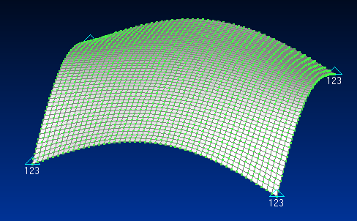
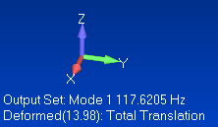
Femap: Mode Shape 1
The fundamental mode at 117.6 Hz has 93.3% of the total modal mass in the T3 axis
The acceleration response also depends on higher modes

Slide 5
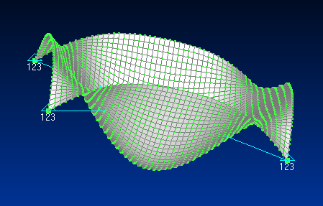
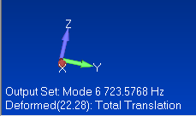
Femap: Mode Shape 6
The sixth mode at 723 Hz has 3.6% of the total modal mass in the T3 axis
This mode has the highest contribution to the T3 peak acceleration response at the center node to the input shock
This partly is because there is more input energy at this frequency than at the fundamental frequency and also this mode has the highest eigenvector response at the center node

Slide 6
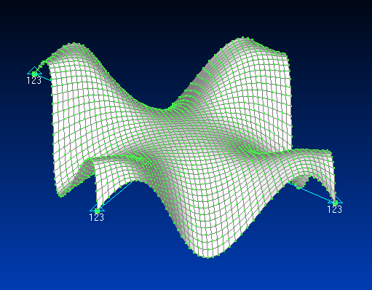
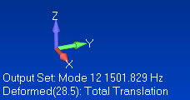
Femap: Mode Shape 12
The twelfth mode at 1502 Hz has 1.6% of the total modal mass in the T3 axis

Slide 7
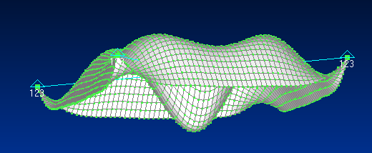
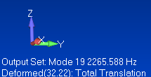
Femap: Mode Shape 19
The 19th mode at 2266 Hz has only 0.3% of the total modal mass in the T3 axis
But it still makes a significant contribution to the acceleration response

Slide 8
Matlab: Node 1201 Parameters for T3
n | fn (Hz) | Modal Mass Fraction | Participation Factor | Eigenvector
1 | 117.6 | 0.933 | 0.0923 | 13.98
6 | 723.6 | 0.036 | 0.0182 | 22.28
12 | 1502 | 0.017 | 0.0123 | 2.499
19 | 2266 | 0.003 | 0.0053 | 32.22
The Participation Factors & Eigenvectors are shown as absolute values
The Eigenvectors are mass-normalized
Modes 1, 6, 12 & 19 account for 98.9% of the total mass

Slide 9
Procedure, part II
Response spectrum analysis is actually an extension of normal modes analysis
ABSSUM – absolute sum method
SRSS – square-root-of-the-sum-of-the-squares
NRL – Naval Research Laboratory method
The SRSS method is probably the best choice for response spectrum analysis because the modal oscillators tend to reach their respective peaks at different times according to frequency
The lower natural frequency oscillators take longer to peak

Slide 10
ABSSUM Method
Conservative assumption that all modal peaks occur simultaneously
Pick D values directly off of Relative Displacement SRS curve
where is the mass-normalized eigenvector coefficient for coordinate i and mode j
These equations are valid for both relative displacement and absolute acceleration.

Slide 11
SRSS Method
Pick D values directly off of Relative Displacement SRS curve
These equations are valid for both relative displacement and absolute acceleration.

Slide 12
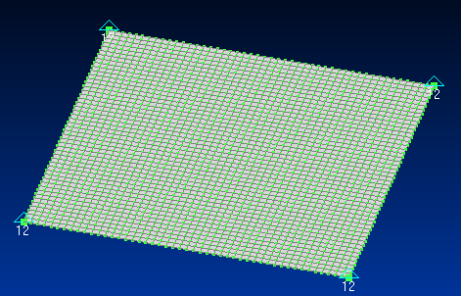
Femap: Constraints
The response spectrum setup has some similarities and differences relative to modal transient
Delete all constraints, functions, and output sets from previous model
Delete the base mass and rigid links if present
Delete all unused nodes
Resume as follows:
Create constraint set call seismic & edit corner node constraints so that only TX & TY are fixed

Slide 13
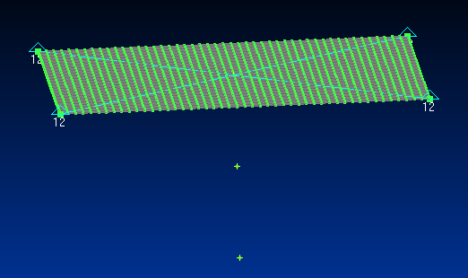
Femap: Added Points and Nodes
Node 2402
Node 2403
Copy center point twice at -3 inch increments in the Z-axis
Place nodes on added points

Slide 14
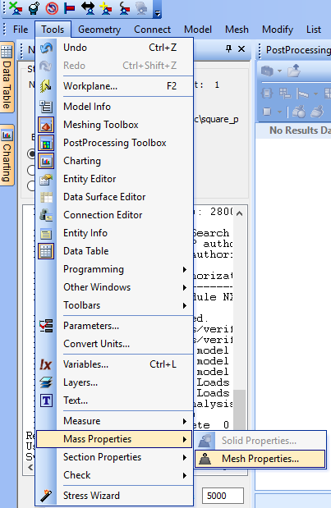
Femap: Mass
Calculate FEA model mass
Select all elements
Result is 0.00913968 lbf sec^2/in
Or 1.6 kg
Copy total mass using Ctrl-C

Slide 15
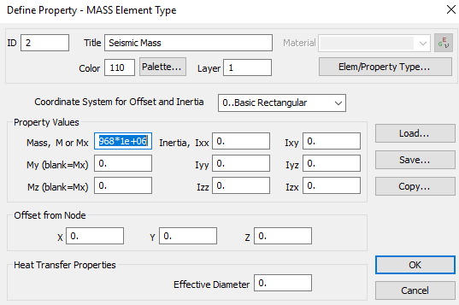
Femap: Seismic Mass
Define Seismic Mass property
Mass value is model mass x 1e+06
Enter the following number in the mass box 0.00913968*1e+06
The edit box is too small to show complete number

Slide 16
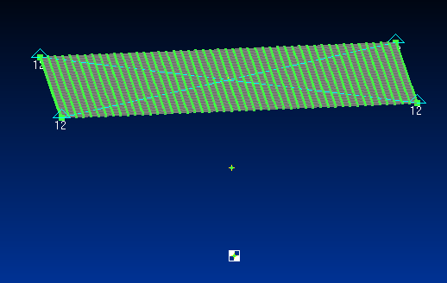
Femap: Seismic Mass Placement
Node 2403, Seismic Mass

Slide 17
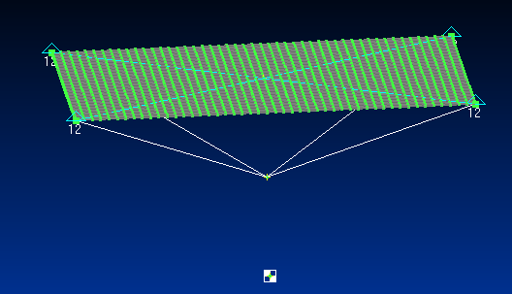
Femap: Rigid Link no. 1, TZ only
Four corner nodes are dependent
Node 2402, Independent

Slide 18
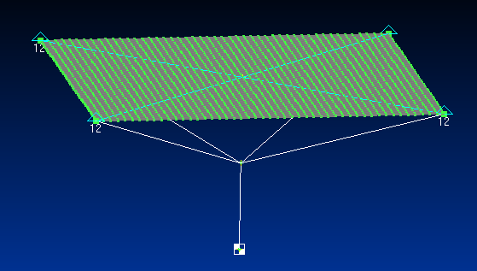
Femap: Rigid Link no. 2, TZ only
Node 2402, Dependent
Node 2403, Independent

Slide 19
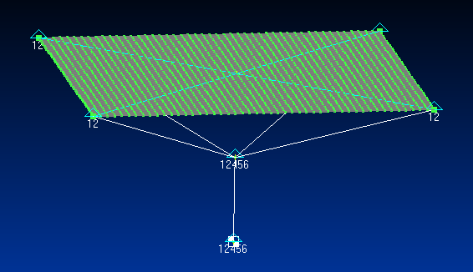
Femap: Add Constraints to Current Constraint Set
All DOF fixed except TZ

Slide 20
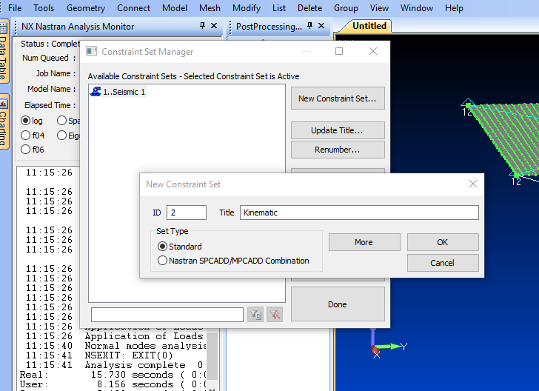
Femap: Create New Constraint Set Called Kinematic

Slide 21
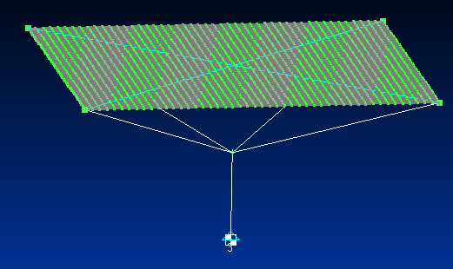
Femap: Add Constraint to Kinematic Set
Constrain TZ
The seismic mass is constrained in TZ which is the response spectrum base drive axis

Slide 22
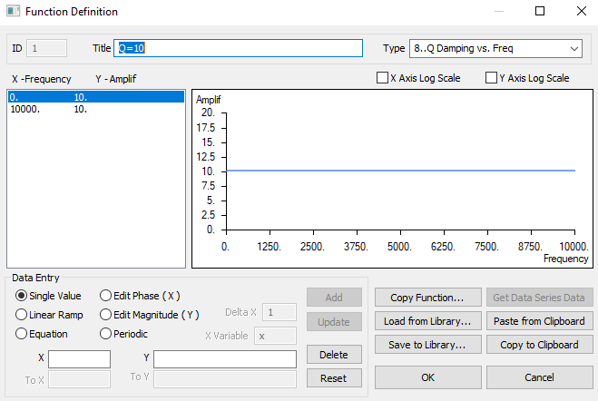
Femap: Define Damping Function
Q=10 is the same as 5% Critical Damping

Slide 23
Shock Response Spectrum Q=10
fn (Hz) | Peak Accel (G)
10 | 10
2000 | 2000
10000 | 2000
Good practice to extrapolate specification down to 10 Hz if it begins at 100 Hz
Because model may have modes below 100 Hz
Aerospace SRS specifications are typically log-log format
So good practice to perform log-log interpolation as shown in following slides
Go to Matlab Workspace and type:
>> spec=[10 10; 2000 2000; 10000 2000]

Slide 24
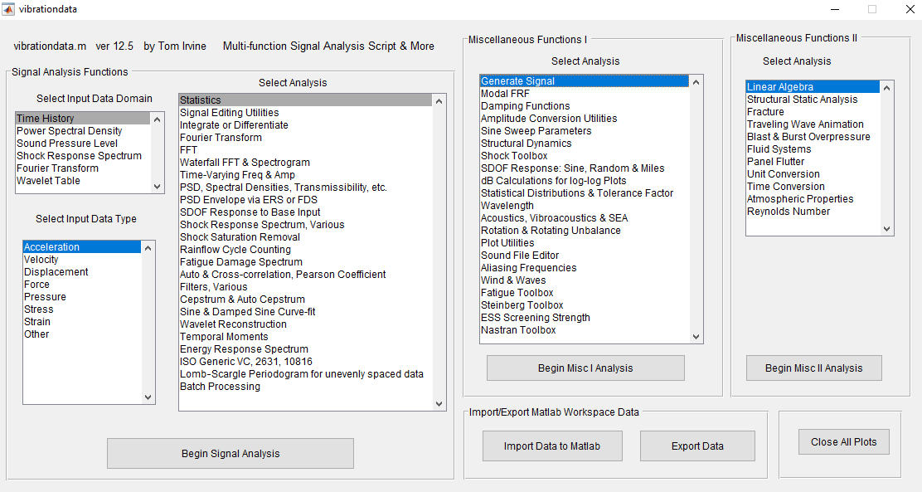
Vibrationdata Matlab GUI

Slide 25
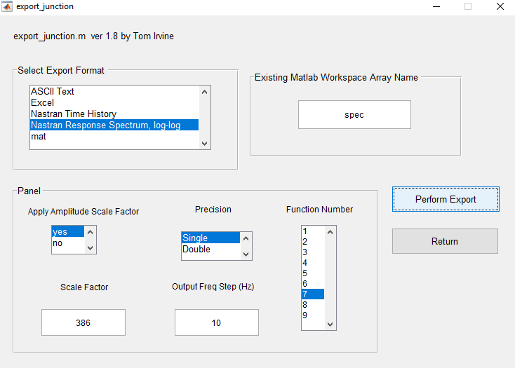
Matlab: Export Data
>> spec=[10 10; 2000 2000; 10000 2000]
Multiply by 386 to convert G to in/sec^2
Save as: srs_Q10.bdf or whatever

Slide 26
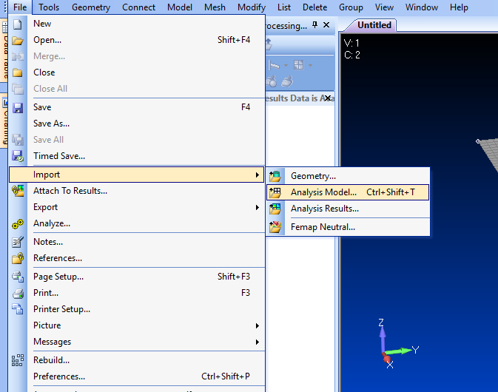
Femap: Import Analysis Model srs_Q10.bdf

Slide 27
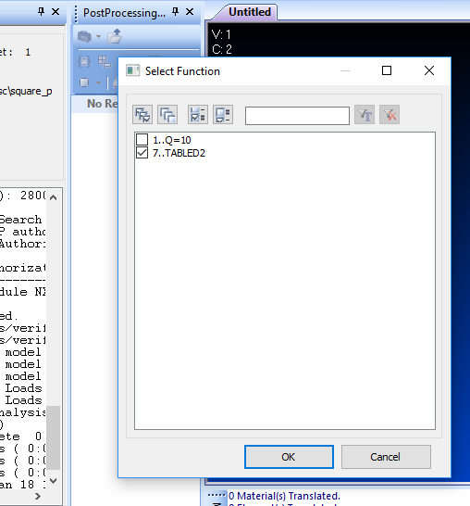
Femap: View Response Spectrum Function

Slide 28
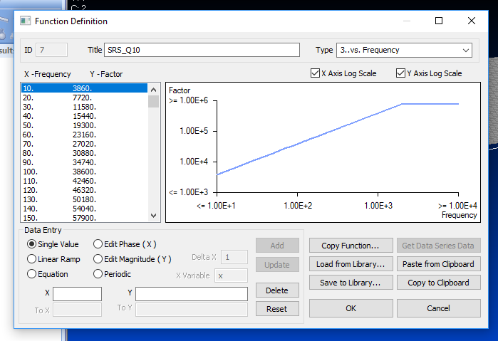
Femap: View Response Spectrum Function
Change title from TABLED2 to SRS_Q10

Slide 29
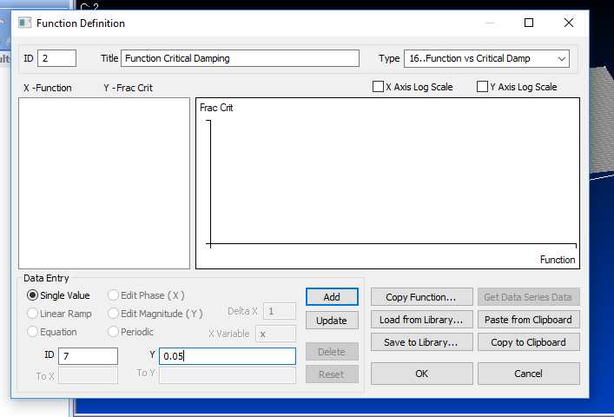
Femap: Define Response Function vs. Critical Damping
For simplicity, the model damping and SRS specification are both Q=10 or 0.05 fraction critical
Function 7 is the SRS specification
Specifications for other damping values could also be entered as functions and referenced in this table, as needed for interpolation if the model has other damping values
Multiple SRS specifications is covered in Unit 202

Slide 30
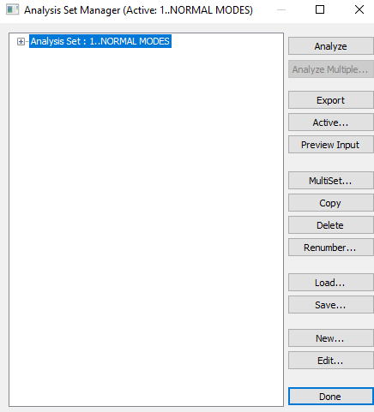
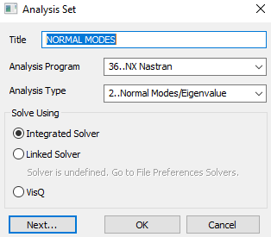
Femap: Define Normal Modes Analysis with Response Spectrum

Slide 31
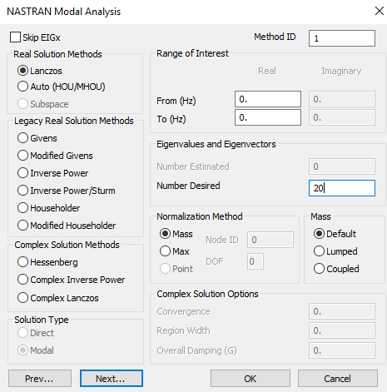
Femap: Define Normal Modes Analysis Parameters
Solve for 20 modes

Slide 32
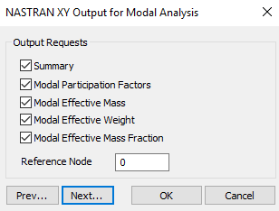
Femap: Define Nastran Output for Modal Analysis

Slide 33
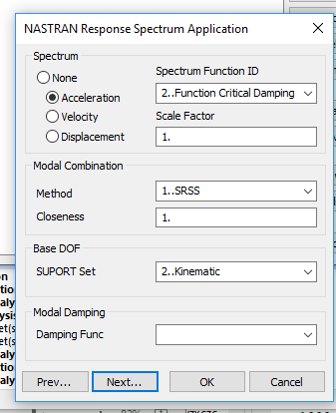
Femap: SRS Cross-Reference Function
This is the function that relates the SRS specifications to their respective damping cases
“Square root of the sum of the squares”
The responses from modes with closely-spaced frequencies will be lumped together

Slide 34
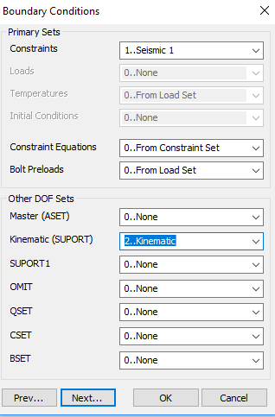
Femap: Define Boundary Conditions
Main Constraint function
Base input constraint, TZ for this example

Slide 35
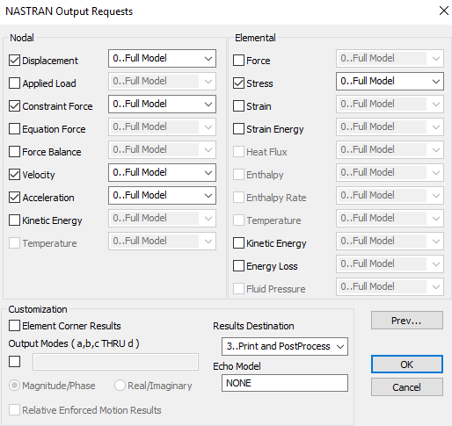
Femap: Define Outputs
Quick and easy to output results at all nodes & elements for response spectrum analysis
Only subset of nodes & elements was output for modal transient analysis due to file size and processing time considerations
Get output f06 file

Slide 36
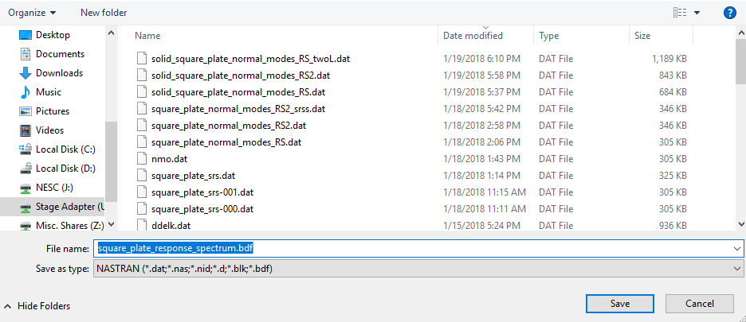
Femap: Export Nastran Analysis File
Export analysis file
Run in Nastran

Slide 37
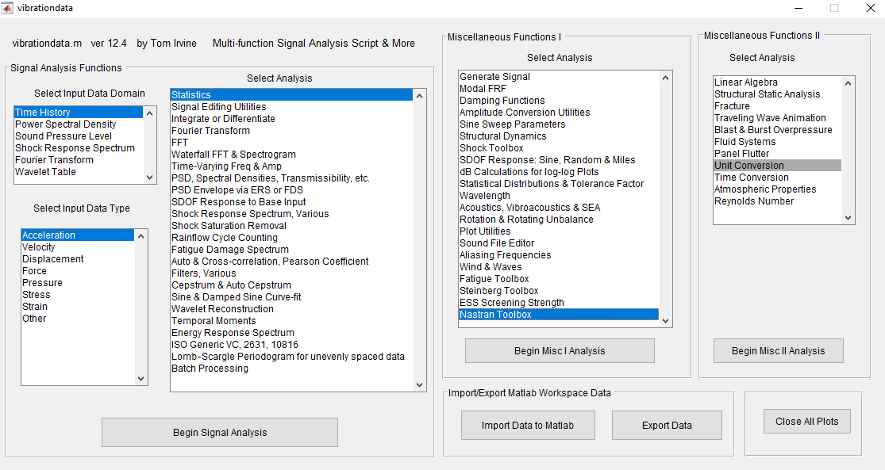
Matlab: Vibrationdata GUI

Slide 38
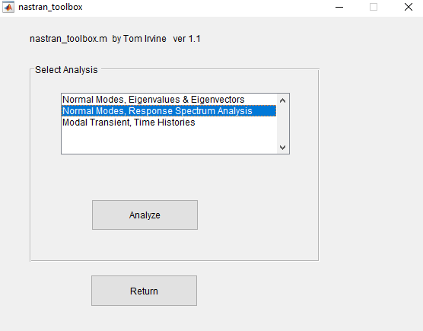
Matlab: Nastran Toolbox

Slide 39
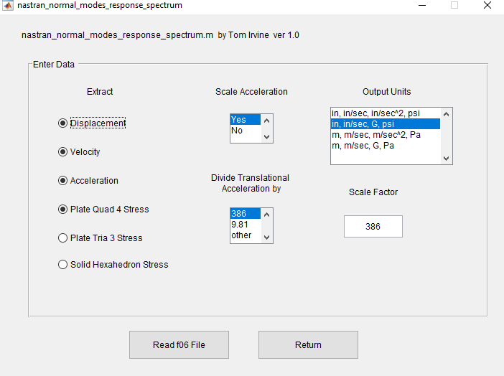
Matlab: Response Spectrum Results from f06 File

Slide 40
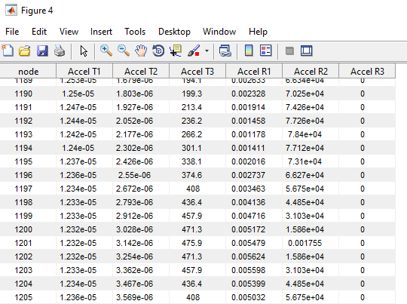
Matlab: Response Spectrum Acceleration Results
Center node 1201 has T3 peak acceleration = 475.9 G from response spectrum analysis
Modal transient result from Unit 200 was 461 G for this node

Slide 41
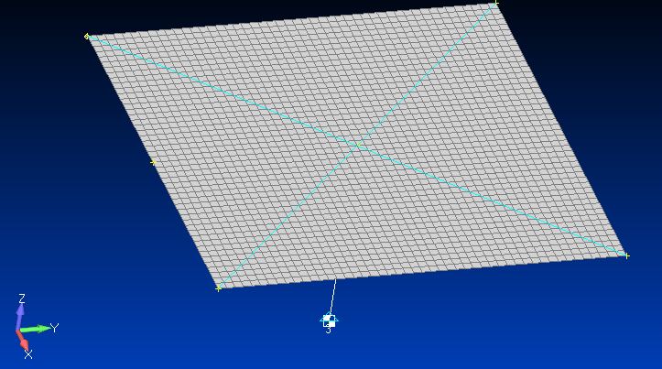
Matlab: Response Spectrum Acceleration Results (cont)
Node 49
Node 1201
Center node 1201 had T3 peak acceleration = 475.9 G
Edge node 49 had highest T3 peak acceleration = 612.5 G
By symmetry, three other edge nodes should have this same acceleration
But node 1201 had highest displacement and velocity responses

Slide 42
Matlab: Response Spectrum Results
Maximum Displacements:
node value
T1: 2376 0.00000 in
T2: 931 0.00000 in
T3: 1201 0.10746 in
R1: 1 0.02054 rad/sec
R2: 1 0.02054 rad/sec
R3: 1 0.00000 rad/sec
Maximum accelerations:
node value
T1: 2376 0.000 G
T2: 931 0.000 G
T3: 49 612.541 G
R1: 1 116739.700 rad/sec^2
R2: 1 116739.700 rad/sec^2
R3: 1 0.000 rad/sec^2
Maximum velocities:
node value
T1: 2376 0.000 in/sec
T2: 931 0.000 in/sec
T3: 1201 83.665 in/sec
R1: 1 20.246 rad/sec
R2: 1 20.246 rad/sec
R3: 1 0.000 rad/sec
Maximum Quad4 Stress:
element value
NORMAL-X : 1105 6047.053 psi
NORMAL-Y : 24 6047.053 psi
SHEAR-XY : 50 4798.865 psi
MAJOR PRNCPL: 24 6047.816 psi
MINOR PRNCPL: 1128 4997.801 psi
VON MISES : 50 8400.833 psi

Slide 43
Acceleration Response Check for Node 1201 T3
n | fn (Hz) | PF | Eigen vector | Q | Interpolated SRS (G) | | PF x Eig x Spec | (G) | | PF x Eig x Spec |² (G²)
1 | 117.6 | 0.0923 | 13.98 | 10 | 117.6 | 151.7 | 23027
6 | 723.6 | 0.0182 | -22.28 | 10 | 723.6 | 293.4 | 86093
12 | 1502 | 0.0123 | 2.499 | 10 | 1502 | 46.2 | 2131
19 | 2266 | 0.0053 | 32.22 | 10 | 2000 | 341.5 | 116644
 |  |  |  |  |  | sum = 833 G | sum = 227896 G²
 |  |  |  |  |  |  | sqrt of sum = 477 G
Center node 1201 had T3 peak acceleration = 475.9 G from the FEA
The FEA value passes the modal combination check

Slide 44
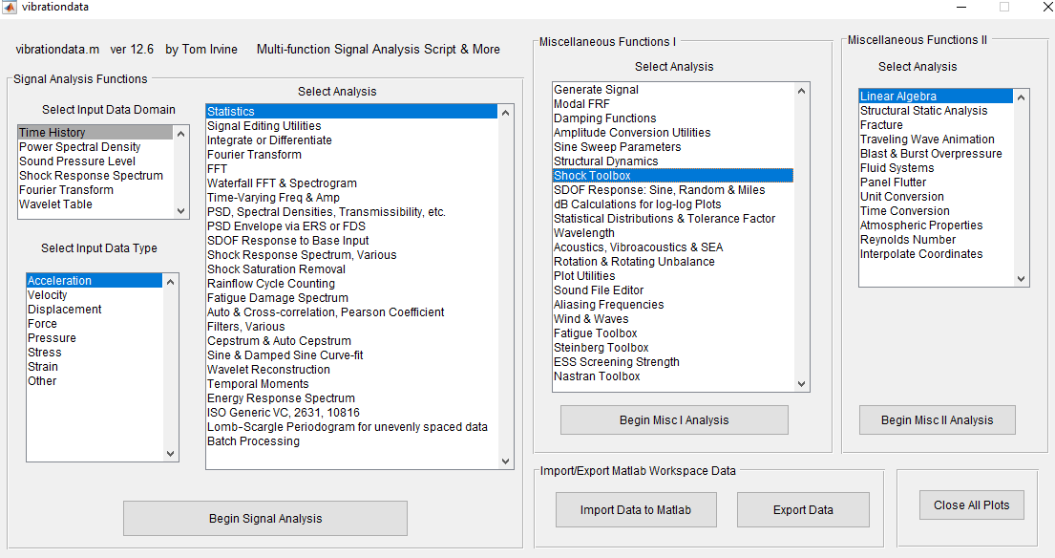
Vibrationdata GUI

Slide 45
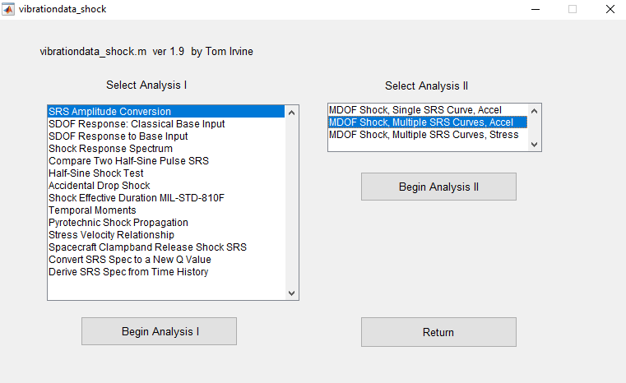
Vibrationdata Shock Toolbox

Slide 46
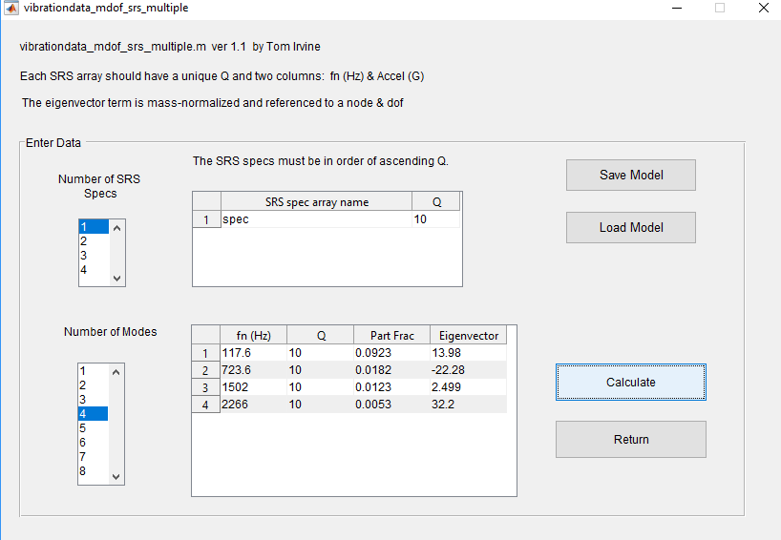
Vibrationdata SRS Modal Combination
>> spec=[10 10; 2000 2000; 10000 2000]

Slide 47
Vibrationdata SRS Modal Combination Results
SRS Q=10
fn(Hz) Accel(G)
10.0 10.0
2000.0 2000.0
10000.0 2000.0
fn Q=10
(Hz) SRS(G)
117.6 117.6
723.6 723.6
1502 1502
2266 2000
fn Part Eigen SRS Modal Response
(Hz) Factor vector Accel(G) Accel(G)
117.6 0.0923 13.98 117.6 151.7
723.6 0.0182 -22.28 723.6 293.4
1502 0.0123 2.499 1502 46.17
2266 0.0053 32.2 2000 341.3
ABSSUM= 832.7 G SRSS= 477.2 G

Slide 48
Acceleration Response Check for Node 49 T3
n | fn (Hz) | PF | Eigen vector | Q | Interpolated SRS (G) | | PF x Eig x Spec | (G) | | PF x Eig x Spec |² (G²)
1 | 117.6 | 0.0923 | 9.81 | 10 | 117.6 | 106.5 | 11339
6 | 723.6 | 0.0182 | 17.92 | 10 | 723.6 | 236.0 | 55695
12 | 1502 | 0.0123 | -28.5 | 10 | 1502 | 526.5 | 277230
19 | 2266 | 0.0053 | -16.6 | 10 | 2000 | 176.0 | 30962
 |  |  |  |  |  | sum = 1045 G | sum = 375225 G²
 |  |  |  |  |  |  | sqrt of sum = 613 G
Edge node 49 had T3 peak acceleration = 612.5 G from the FEA
The FEA value passes the modal combination check

Slide 49
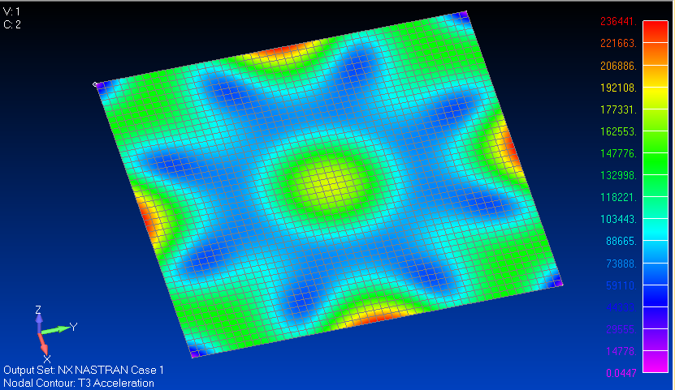
Femap: T3 Acceleration Contour Plot, unit = in/sec^2
Import the f06 file into Femap and then View > Select

Slide 50
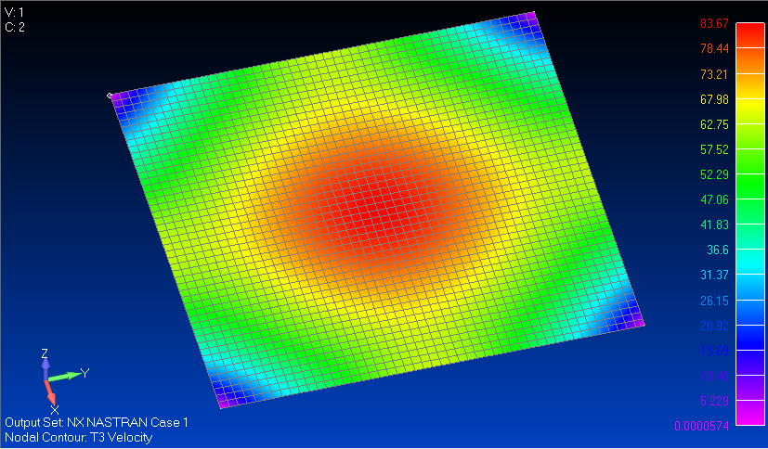
Femap: T3 Velocity Contour Plot, unit = in/sec

Slide 51
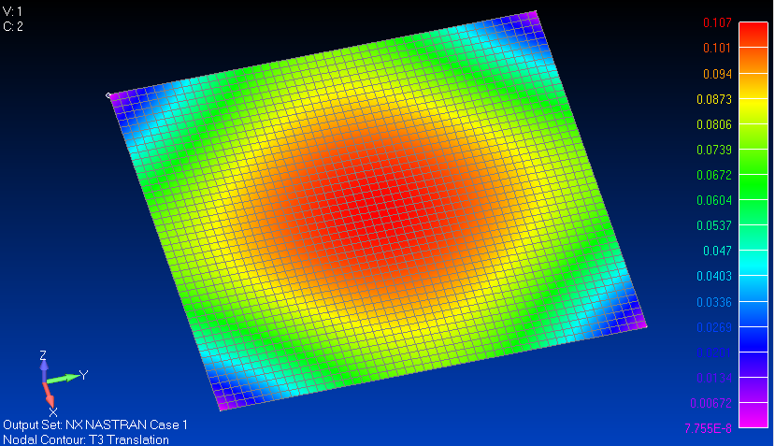
Femap: T3 Translation Contour Plot, unit = inch
This is actually the relative displacement

Slide 52
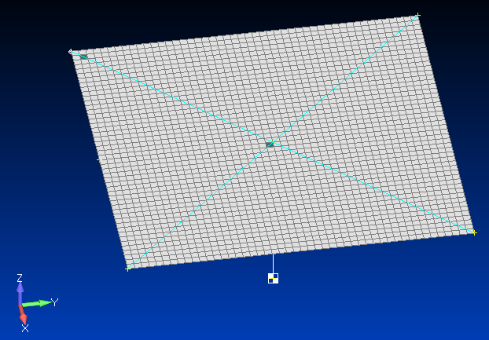
Matlab: Response Spectrum Stress Elements
Node 101
Element 50
Node 1201
Element 1129
Element 50 had the highest Von Mises stress = 8401 psi
Element 1129 had Von Mises stress = 5001 psi

Slide 53
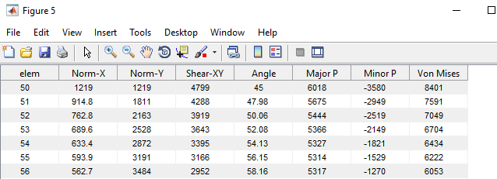
Matlab: Response Spectrum Stress Results

Slide 54
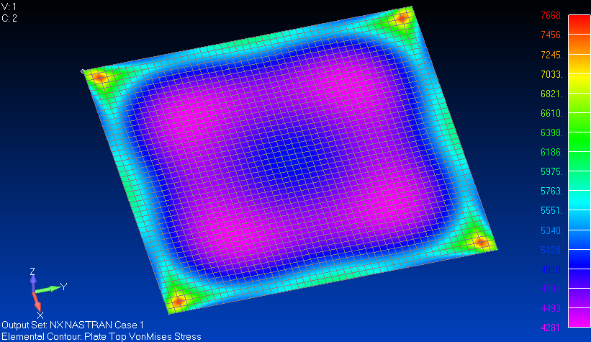
Femap: Von Mises Stress Contour Plot

Slide 55
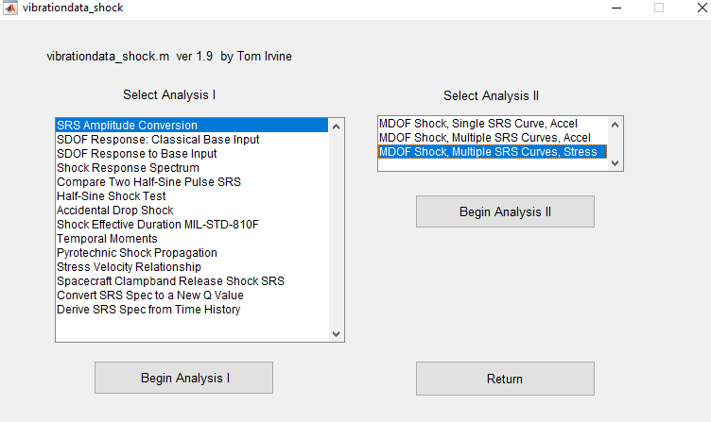
Matlab: Vibrationdata Shock Toolbox

Slide 56
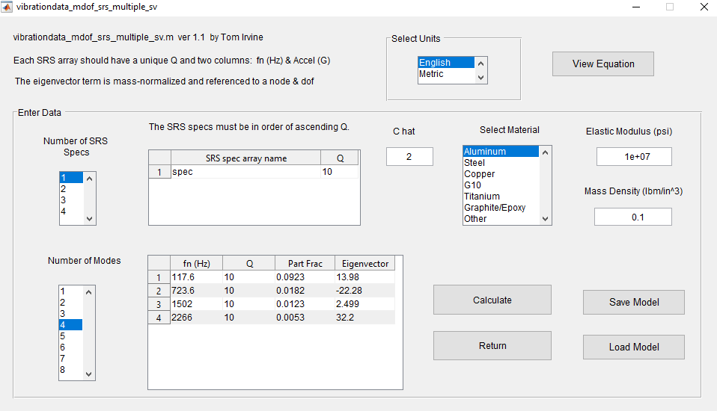
Matlab: MDOF SRS Stress Analysis for Node 1201
The peak velocity response occurs at center Node 1201
The peak stress occurs near each of the four corners
The stress-velocity calculation accounts for this difference

Slide 57
Stress-Velocity Equation
The stress [σ_{n}]_{max} for mode n is:
E | Elastic modulus
ρ | Mass per volume
[V_{n}]_{max} | Modal velocity
Ĉ is a constant of proportionality dependent upon the geometry of the structure, often assumed for complex equipment to be 4 < Ĉ < 8
Ĉ ≈ 2 for all normal modes of homogeneous plates and beams

Slide 58
Matlab: Peak MDOF SRS Stress from Node 1201 velocity
SRS Q=10
fn(Hz) Accel(G)
10.0 10.0
2000.0 2000.0
10000.0 2000.0
fn Q=10
(Hz) SRS(G)
117.6 117.6
723.6 723.6
1502 1502
2266 2000
fn Q Part Eigen Accel PV SRS Modal Response
(Hz) Factor vector SRS(G) (in/sec) stress(psi)
117.6 10 0.0923 13.98 117.6 61.43 8070
723.6 10 0.0182 -22.28 723.6 61.43 2536
1502 10 0.0123 2.499 1502 61.43 192.2
2266 10 0.0053 32.2 2000 54.22 942
ABSSUM= 11740 psi SRSS= 8513.1 psi
The peak FEA response spectrum stress for the whole plate was 8401 psi
FEA stress passes sanity check, but a lower Ĉ value may be justified so that the SRSS agrees more closely with the FEA results

Slide 59
Future Work
Expand Nastran stress post-processing options in Vibrationdata GUI
Include strain
Please contact Tom Irvine Email: tom@irvinemail.org if you have suggestions or find bugs in the Vibrationdata GUI
Homework
Repeat analysis with triangular plate elements
Experiment with different mesh densities
Repeat analysis with an alternate base input response spectrum
Compare results from Absolute Sum and SRSS methods

